Slide 1

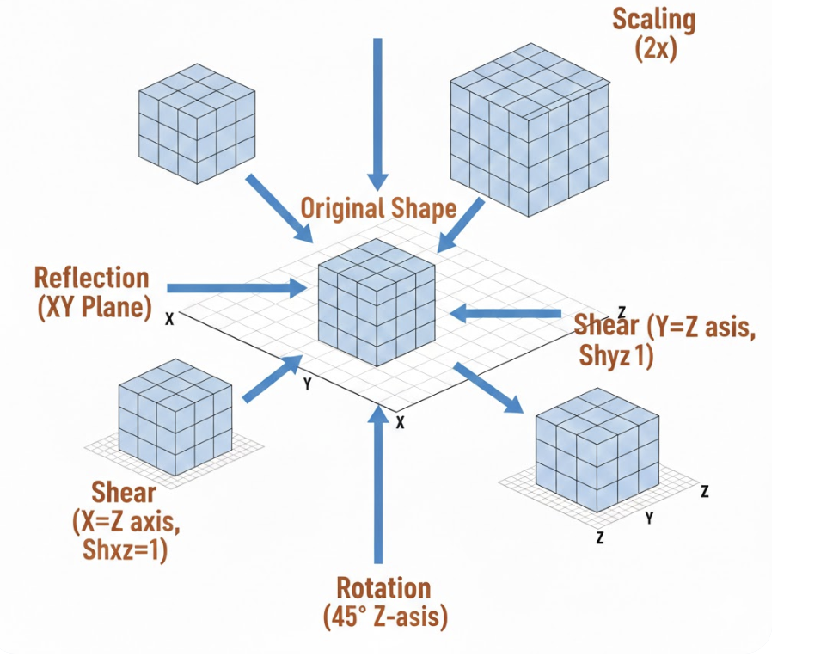
Computer Graphics 3D Transformation
Lecture 7
Syada Tasmia Alvi
Senior Lecturer Department of Computer Science and Engineering Daffodil International University, DIU
‹#›
Notes:
‹#›

Slide 2
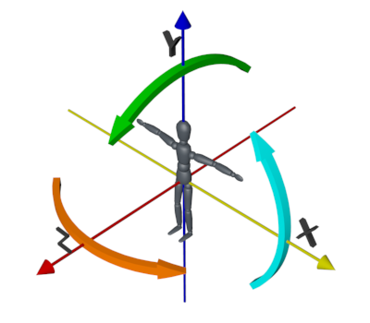
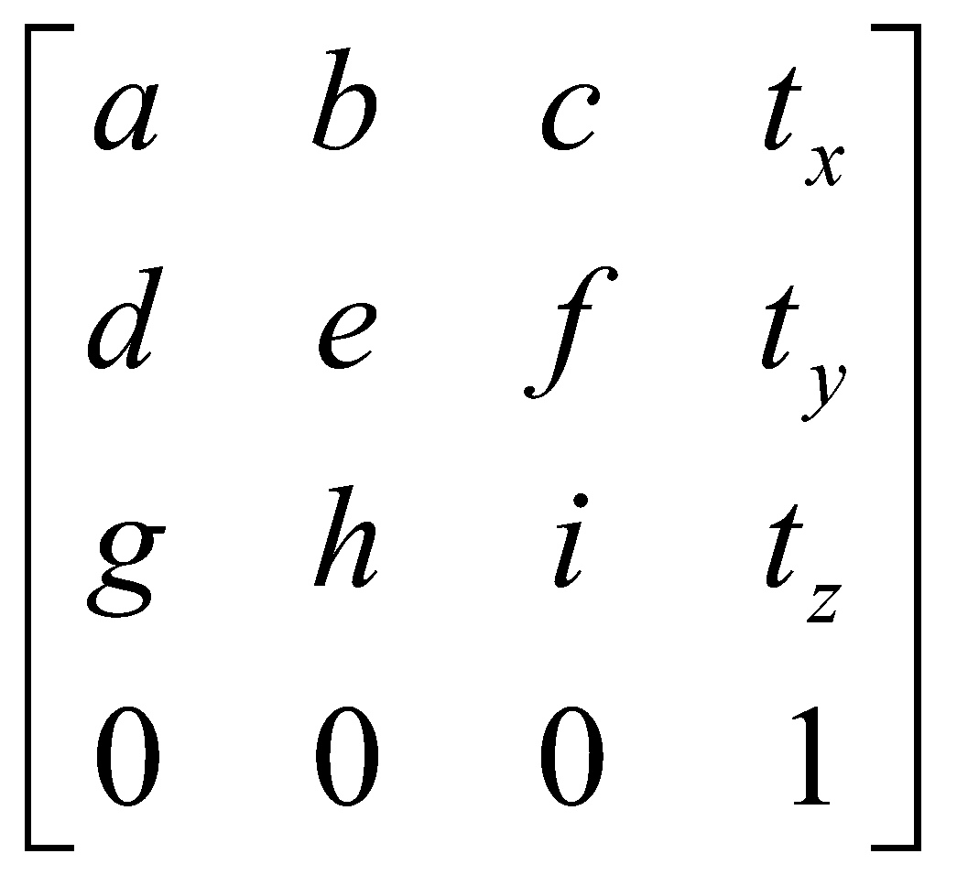
3D Transformations
When the transformation takes place on a 3D plane. It is called 3D transformation
Generalize from 2D by including z coordinate Straight forward for translation and scale, rotation more difficult
Homogeneous coordinates: 4 components
Transformation matrices: 4×4 elements
Department of CSE, Daffodil International University
‹#›

Slide 3
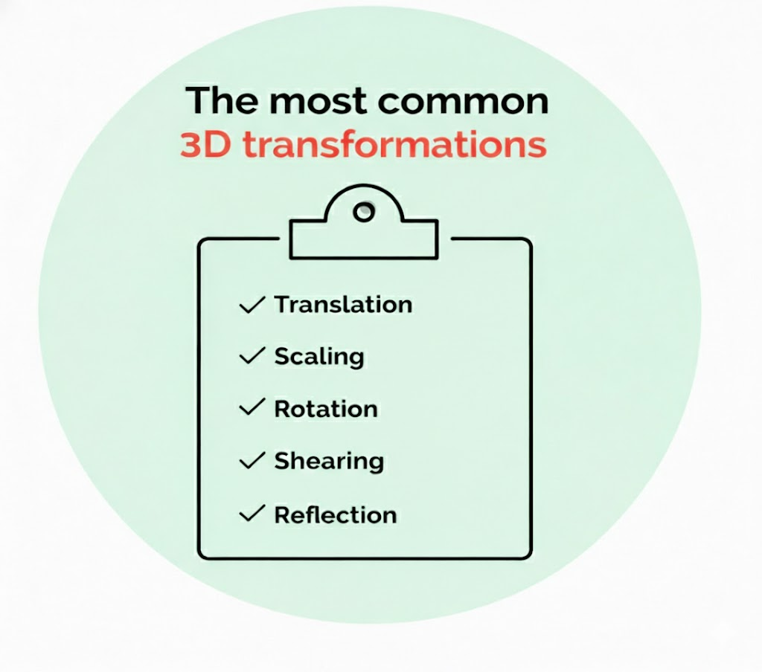
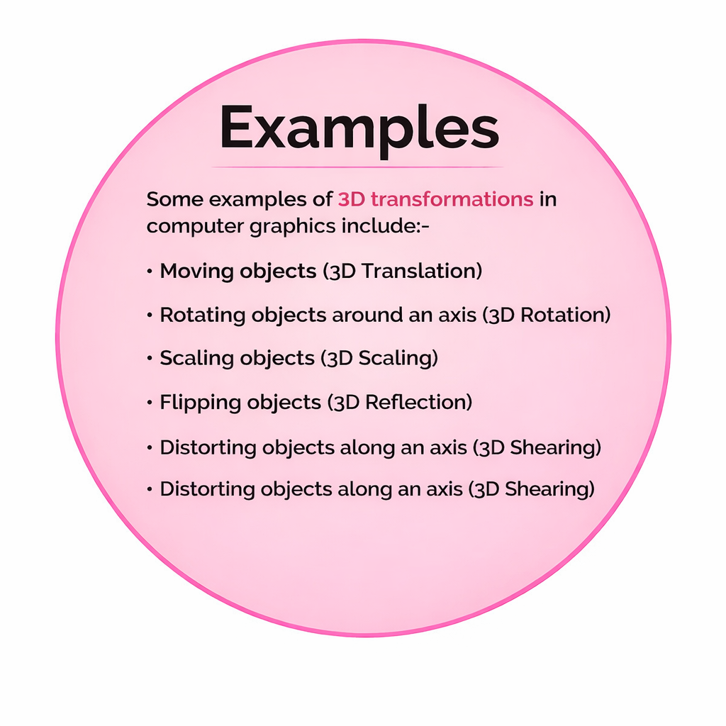
3D Transformations Types
Department of CSE, Daffodil International University
‹#›

Slide 4
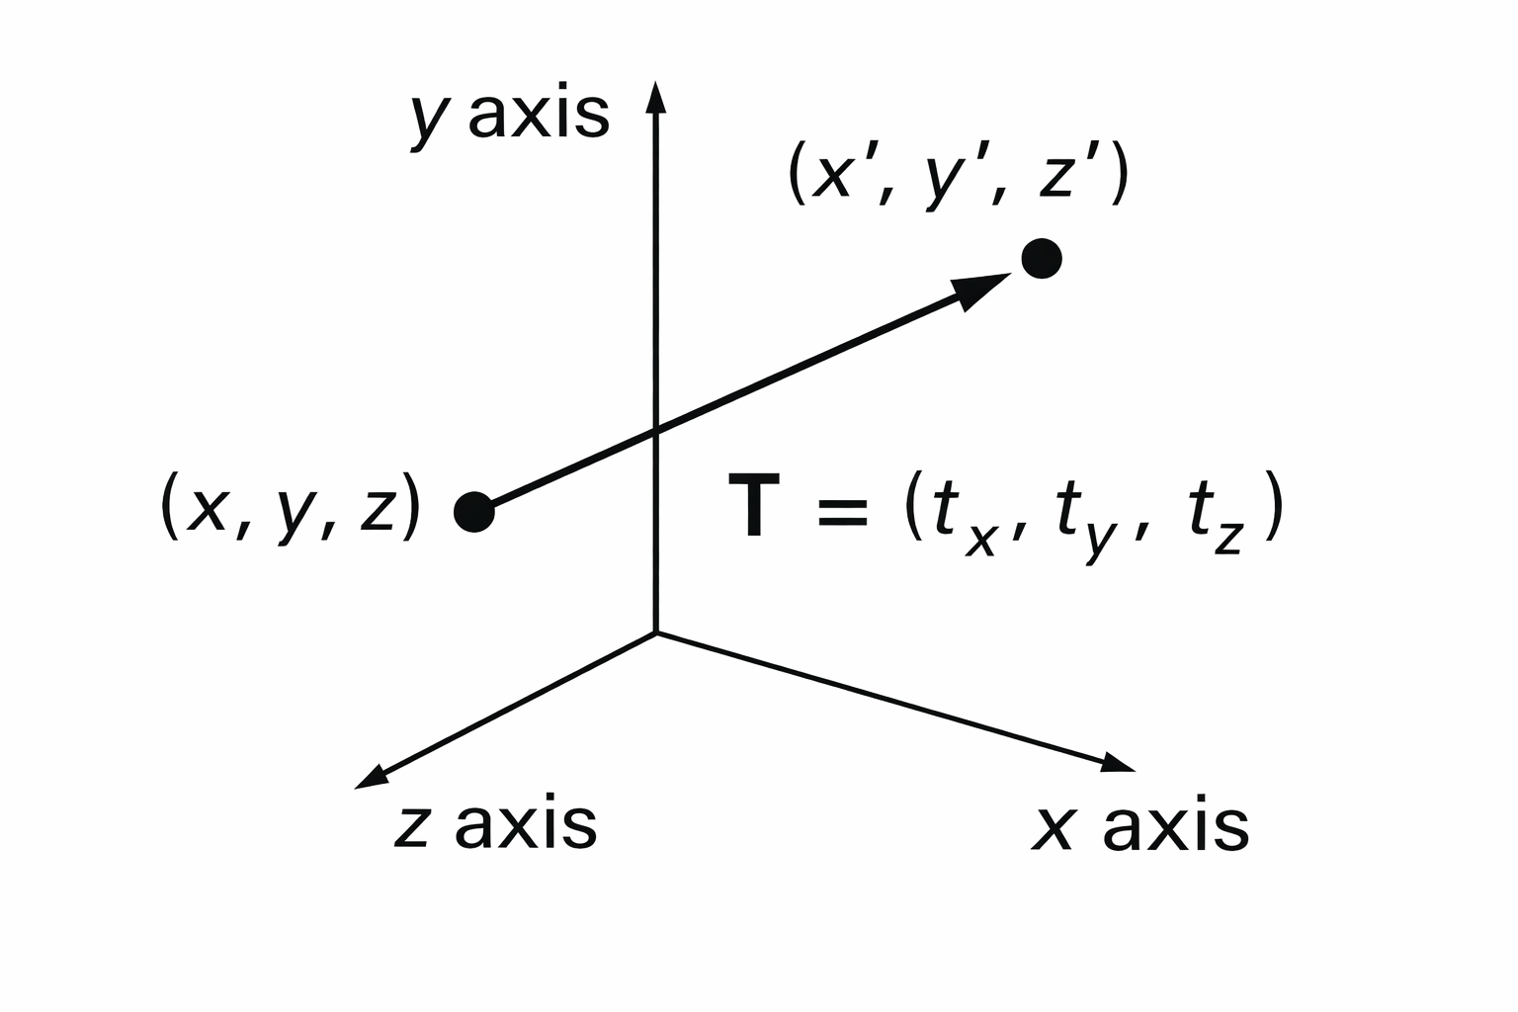
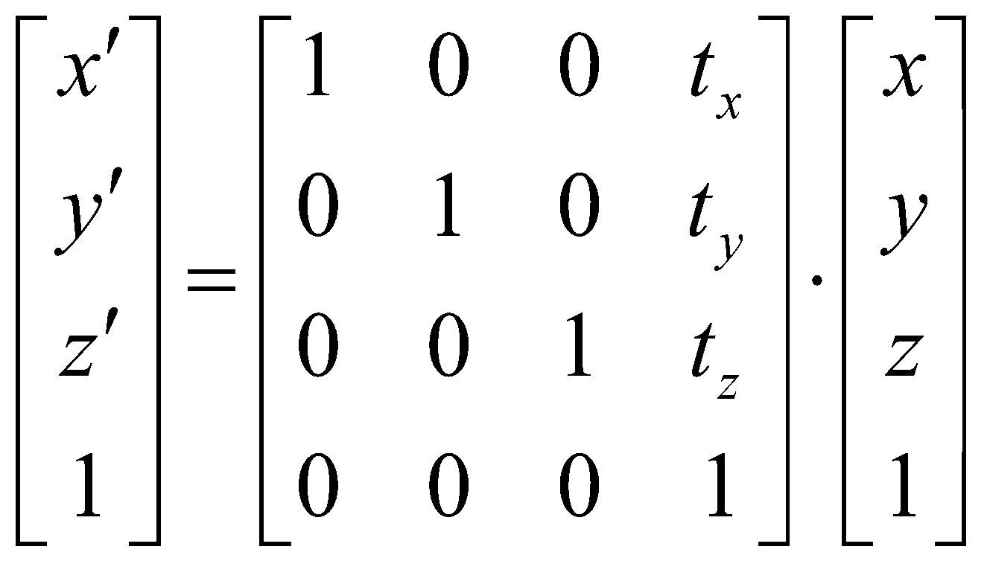
3D Transformations (Translation)
Moving of an object is called translation.
In 3-dimensional homogeneous coordinate representation , a point is transformed from position P = ( x, y , z) to P’=( x’, y’, z’)
This can be written as:- Using P’ = T . P
Translation of objects
Department of CSE, Daffodil International University
‹#›

Slide 5
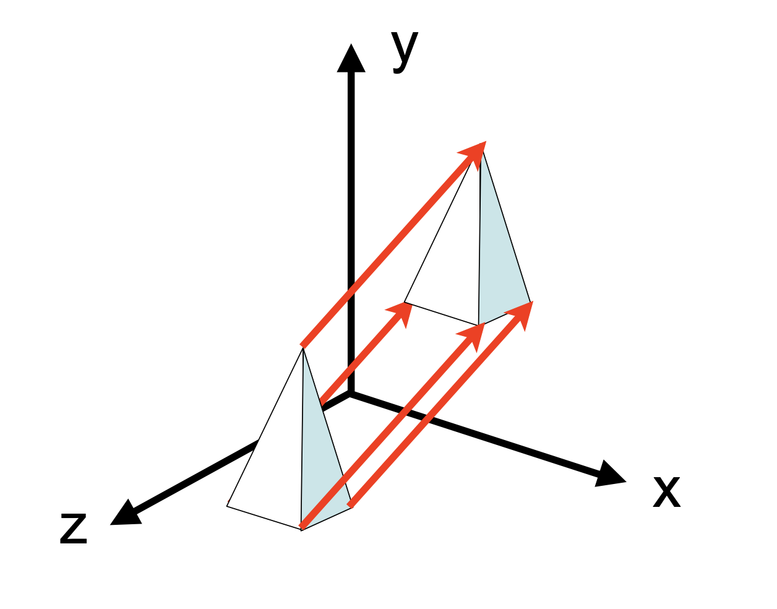
3D Transformations (Translation)
The matrix representation is equivalent to the three equation.
x’=x+ t_{x} ,
y’=y+ t_{y} ,
z’=z+ t_{z}
Where parameter t_{x ,} t_{y ,} t_{z} are specifying translation distance for the coordinate directions x, y, and z, are assigned any real value.
Department of CSE, Daffodil International University
‹#›

Slide 6

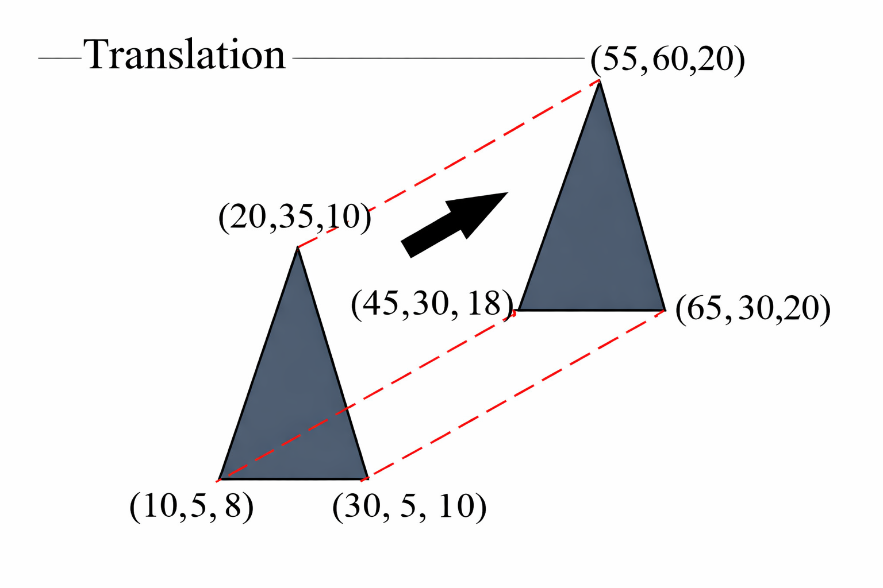

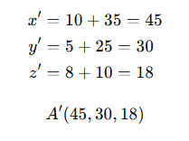
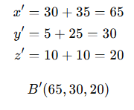
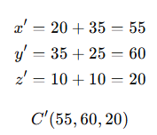
2D Transformations (Translation Example)
Perform translation transformation on the following figure where the given translation distances are t_{x} = 35, t_{y}= 25, and t_{z} = 10
Solution:
C′
C
A′
B′
For Point A (10, 5, 8),
For Point B (30, 5, 10),
For Point C (20, 35, 10),
A
B
Department of CSE, Daffodil International University
‹#›

Slide 7
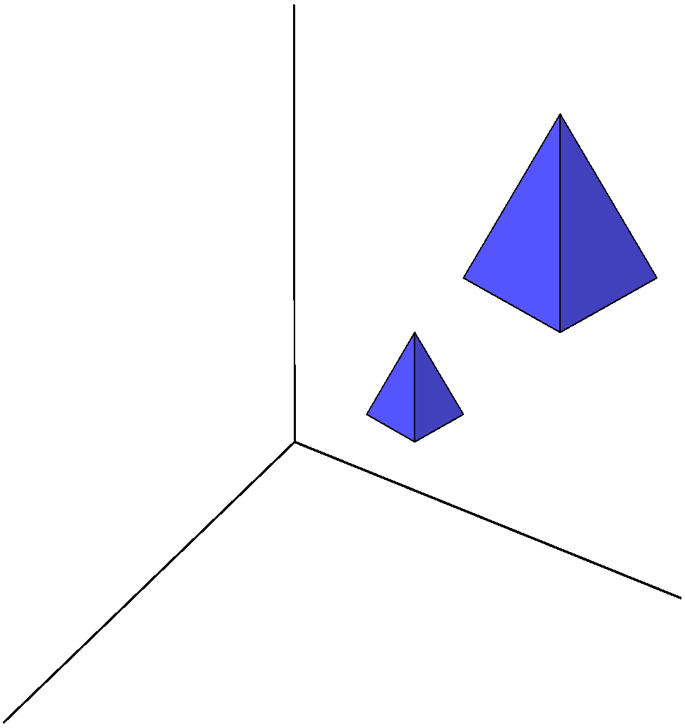
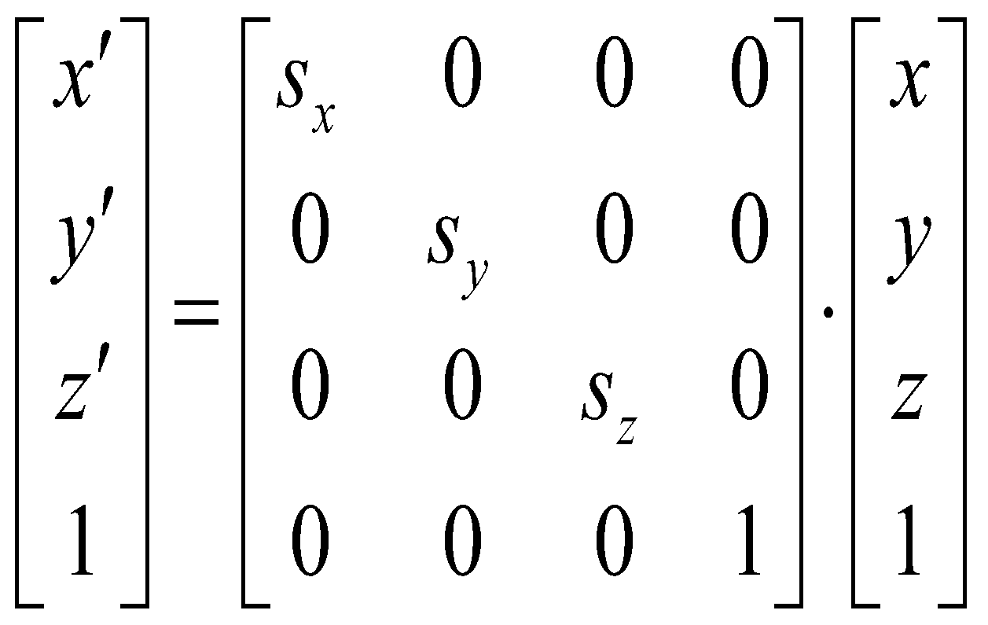
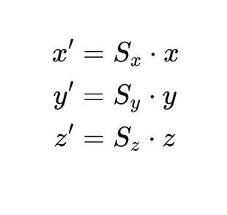
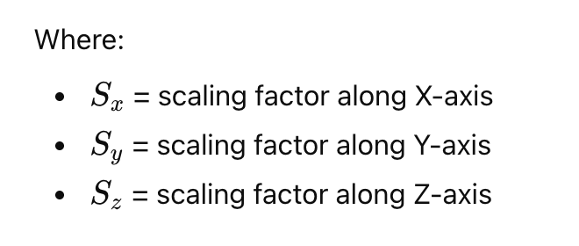
3D Transformations (Scaling)
Changes the size of the object and repositions the object relative to the coordinate origin.
Scaling of objects
The equations for scaling,
‹#›

Slide 8
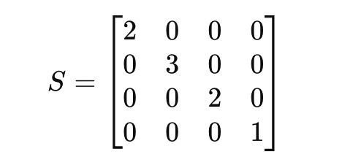
3D Transformations (Scaling Example)
Consider the above problem where a cube "OABCDEFG" is given with O(0, 0, 0), A(0, 4, 0), B(0, 4, 4), C(4, 4, 0), D(4, 4, 4), E(4, 0, 0), F(0, 0, 4), and G(4, 0, 4), 4) and we are given the scaling factors Sx, Sy, and Sz. Perform a scaling operation over the cube.
Scaling factors: S_{x} = 2, S_{y} = 3, S_{z} = 2
Transformation Equation,
P' = S × P
For a point P(x,y,z),
Department of CSE, Daffodil International University
‹#›

Slide 9
3D Transformations (Scaling Example)
Consider the above problem where a cube "OABCDEFG" is given with O(0, 0, 0), A(0, 4, 0), B(0, 4, 4), C(4, 4, 0), D(4, 4, 4), E(4, 0, 0), F(0, 0, 4), and G(4, 0, 4), 4) and we are given the scaling factors Sx, Sy, and Sz. Perform a scaling operation over the cube.
For point O (0,0,0)
x' = 2 × x = 2 × 0 = 0
y' = 3 × y = 3 × 0 = 0
z' = 2 × z = 2 × 0 = 0
Scaled Point O' (0, 0, 0)
For point A (0, 4, 0)
x' = 2 × x = 2 × 0 = 0
y' = 3 × y = 3 × 4 = 12
z' = 2 × z = 2 × 0 = 0
Scaled Point A' (0, 12, 0)
For point B (0, 4, 4)
x' = 2 × x = 2 × 0 = 0
y' = 3 × y = 3 × 4 = 12
z' = 2 × z = 2 × 4 = 8
Scaled Point B' (0, 12, 8)
For point C (4, 4, 0)
x' = 2 × x = 2 × 4 = 8
y' = 3 × y = 3 × 4 = 12
z' = 2 × z = 2 × 0 = 0
Scaled Point C' (8,12,0)
For point D (4, 4, 4)
x' = 2 × x = 2 × 4 = 8
y' = 3 × y = 3 × 4 = 12
z' = 2 × z = 2 × 4 = 8
Scaled Point D' (8, 12, 8)
For Point E (4, 0, 0)
x' = 2 × x = 2 × 4 = 8
y' = 3 × y = 3 × 0 = 0
z' = 2 × z = 2 × 0 = 0
Scaled Point E' (8,0,0)
Department of CSE, Daffodil International University
‹#›

Slide 10
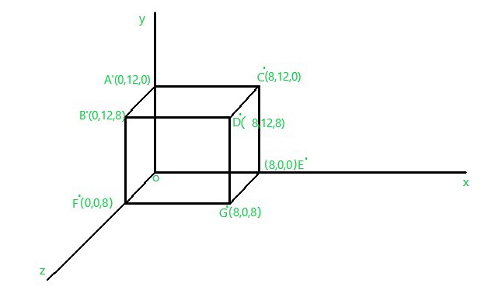
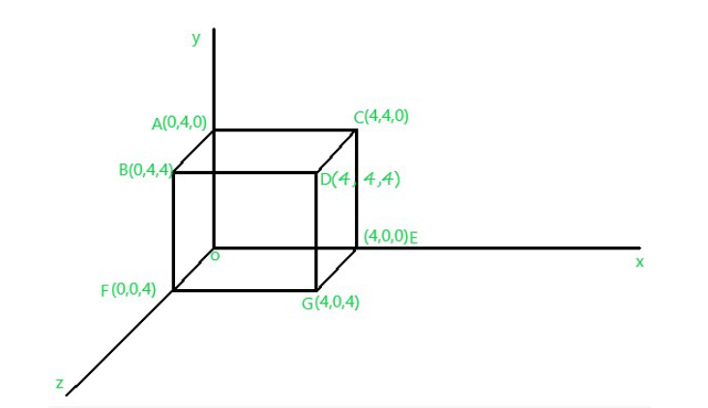
3D Transformations (Scaling Example)
Consider the above problem where a cube "OABCDEFG" is given with O(0, 0, 0), A(0, 4, 0), B(0, 4, 4), C(4, 4, 0), D(4, 4, 4), E(4, 0, 0), F(0, 0, 4), and G(4, 0, 4) and we are given the scaling factors Sx, Sy, and Sz. Perform a scaling operation over the cube.
For point F (0,0,4)
x' = 2 × x = 2 × 0 = 0
y' = 3 × y = 3 × 0 = 0
z' = 2 × z = 2 × 4 = 8
Scaled Point F' (0, 0, 8)
For point G (4, 0, 4)
x' = 2 × x = 2 × 4 = 8
y' = 3 × y = 3 × 0 = 0
z' = 2 × z = 2 × 4 = 8
Scaled Point A' (8, 0, 8)
After Scaling
Before Scaling
Department of CSE, Daffodil International University
‹#›

Slide 11
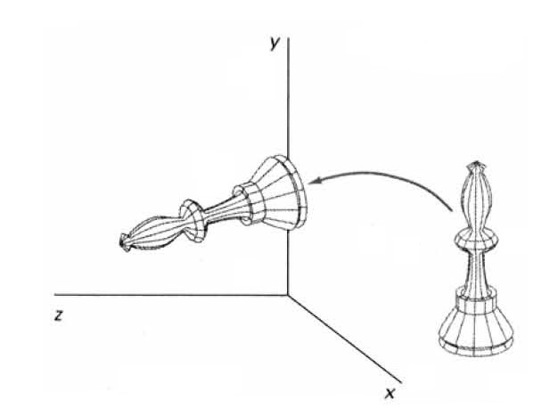
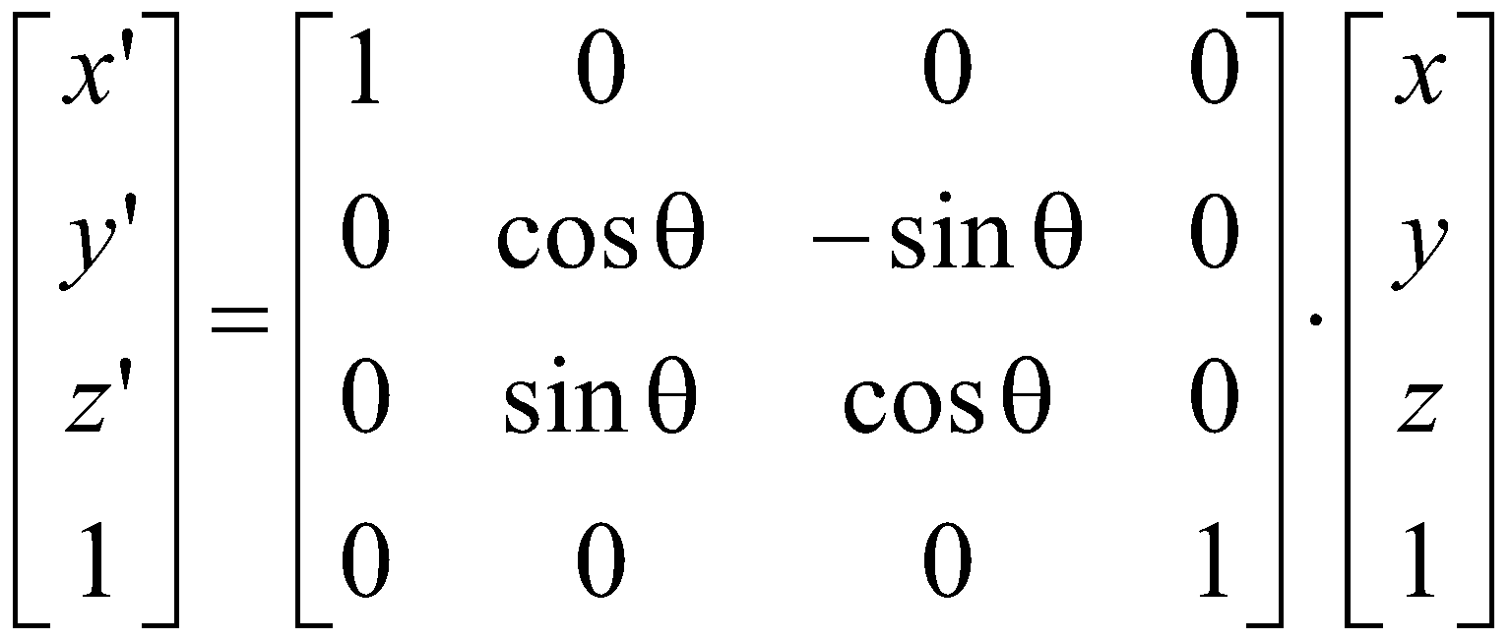
3D Transformations (Rotation)
X-AXIS ROTATION
The equation for X-axis rotation
x’ = x
y’ = y cosθ – z sinθ
z’ = y sinθ + z cosθ
Department of CSE, Daffodil International University
‹#›

Slide 12
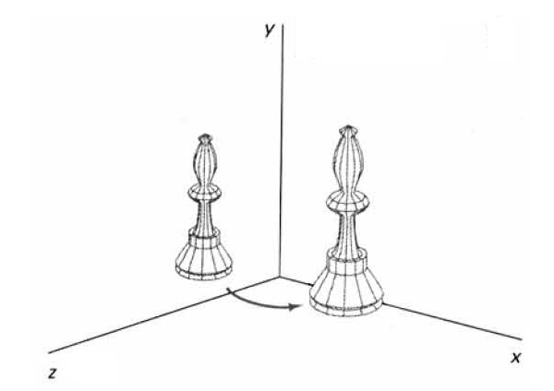
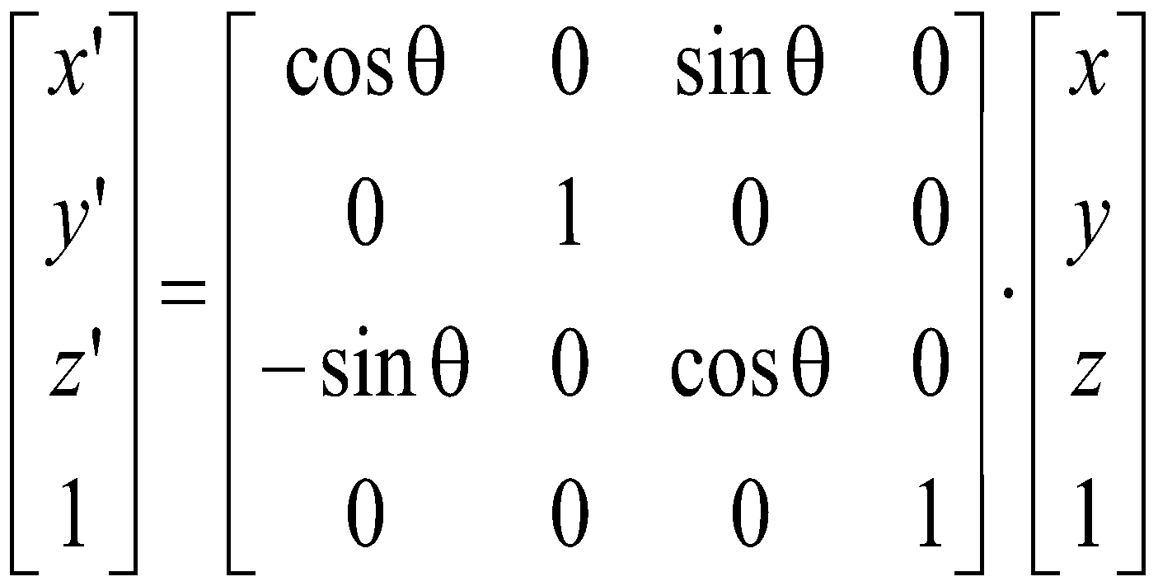
3D Transformations (Rotation)
Y-axis rotation:
The equation for Y-axis rotaion
x’ = x cosθ + z sinθ
y’ = y
z’ = z cosθ - x sinθ
Department of CSE, Daffodil International University
‹#›

Slide 13
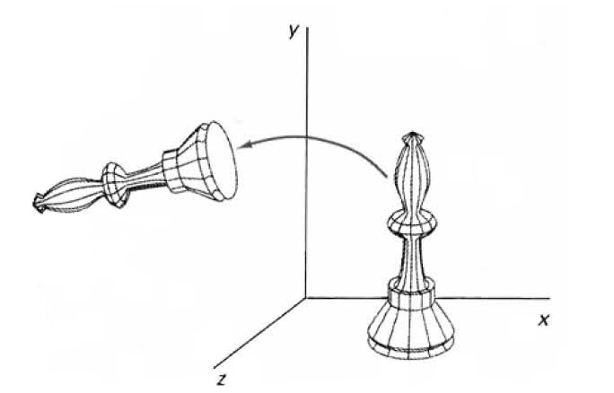
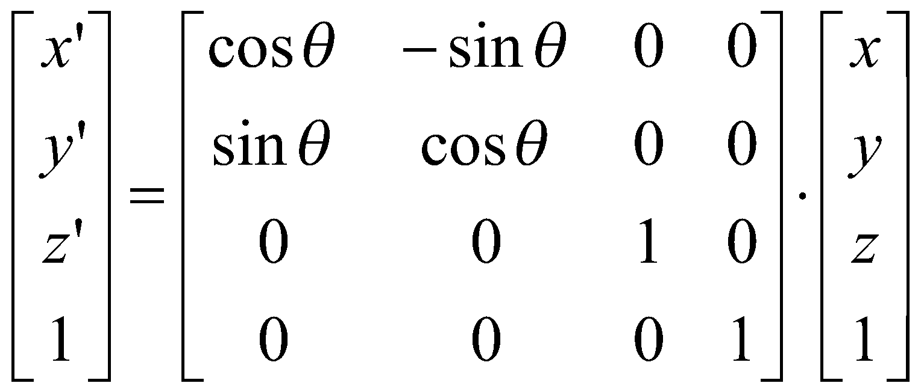
3D Transformations (Rotation)
Z-axis rotation
The equation for Z-axis rotation
x’ = x cosθ – y sinθ
y’ = x sinθ + y cosθ
z’ = z
Department of CSE, Daffodil International University
‹#›

Slide 14
3D Transformations (Rotation Example)
Given a homogeneous point (1, 2, 3). Apply a 90-degree rotation towards the X, Y, and Z axis and find out the new coordinate points
Solution :
Point: (x, y, z) = (1, 2, 3)
Rotation angle θ = 90°
Rotation about X-axis
Rotation about Y-axis
x' = x
y' = y cosθ − z sinθ
z' = y sinθ + z cosθ
x' = 1
y' = 2 cos90° − 3 sin90° = −3
z' = 2 sin90° + 3 cos90° = 2
New coordinate: (1, −3, 2)
x' = z sinθ + x cosθ
y' = y
z' = z cosθ − x sinθ
x' = 3 sin90° + 1 cos90° = 3
y' = 2
z' = 3 cos90° − 1 sin90° = −1
New coordinate: (3, 2, −1)
Department of CSE, Daffodil International University
‹#›

Slide 15
3D Transformations (Rotation Example)
Given a homogeneous point (1, 2, 3). Apply a 90-degree rotation towards the X, Y, and Z axis and find out the new coordinate points
Solution :
Point: (x, y, z) = (1, 2, 3)
Rotation angle θ = 90°
Rotation about Z-axis
Final Results
x' = x cosθ − y sinθ
y' = x sinθ + y cosθ
z' = z
x' = 1 cos90° − 2 sin90° = −2
y' = 1 sin90° + 2 cos90° = 1
z' = 3
New coordinate: (−2, 1, 3)
X-axis rotation → (1, −3, 2)
Y-axis rotation → (3, 2, −1)
Z-axis rotation → (−2, 1, 3)
Department of CSE, Daffodil International University
‹#›

Slide 16
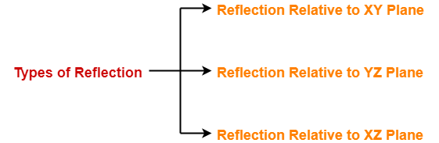
3D Transformations (Reflection)
Reflection in computer graphics is used to emulate reflective objects like mirrors and shiny surfaces Reflection may be an x-axis , y-axis , z-axis. and also in the planes xy-plane,yz-plane , and zx-plane.
Reflection relative to a given Axis are equivalent to 180-degree rotations
Department of CSE, Daffodil International University
‹#›

Slide 17
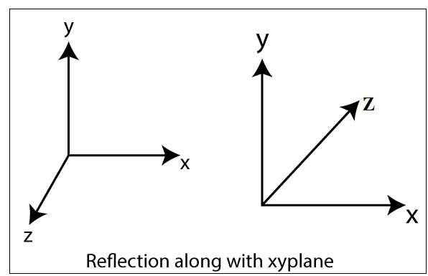
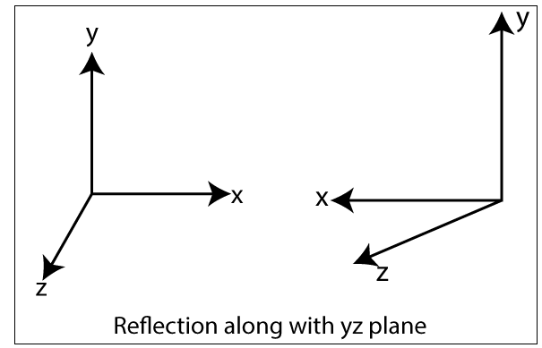
3D Transformations (Reflection)
Reflection Relative to XY Plane:
Reflection Relative to YZ Plane:
This reflection is achieved by using the following reflection equations:
x’ = -x
y’ = y
Z’ = z
This reflection is achieved by using the following reflection equations:
x’ = x
y’ = y
Z’ = -z
Department of CSE, Daffodil International University
‹#›

Slide 18
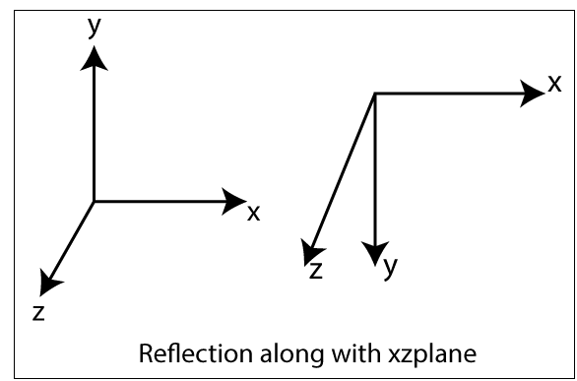
3D Transformations (Reflection)
Reflection Relative to XZ Plane:
This reflection is achieved by using the following reflection equations:
x’ = x
y’ = -y
Z’ = z
Department of CSE, Daffodil International University
‹#›

Slide 19
3D Transformations (Reflection Example)
Given a 3D triangle with coordinate points A(3, 4, 1), B(6, 4, 2), and C(5, 6, 3). Apply the reflection on the XY plane and find out the new coordinates of the object.
Solution:
Reflection plane: XY-plane
Vertices of triangle:
A(3, 4, 1)
B(6, 4, 2)
C(5, 6, 3)
x' = x
y' = y
z' = −z
Only z-coordinate changes sign
For point A (3, 4, 1)
x' = 3
y' = 4
z' = −1
New coordinate, A' = (3, 4, −1)
For point B(6, 4, 2)
x' = 6
y' = 4
z' = −2
New coordinate, B' = (6, 4, −2)
For point C(5, 6, 3)
x' = 5
y' = 6
z' = −3
New coordinate, C' = (5, 6, −3)
Final Results: A' (3, 4, −1), B' (6, 4, −2) , C' (5, 6, −3)
Department of CSE, Daffodil International University
‹#›

Slide 20
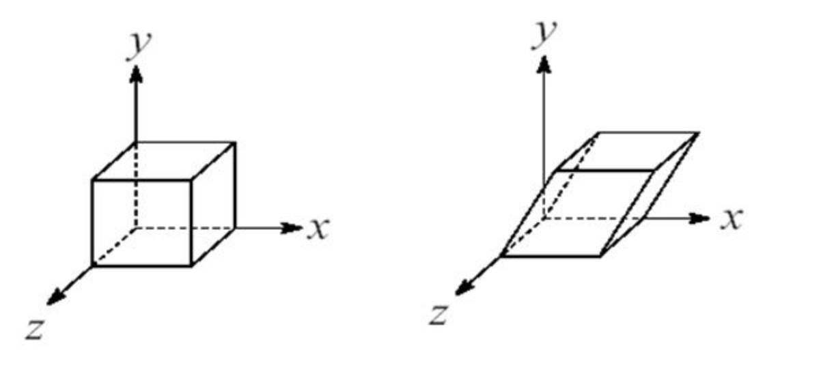
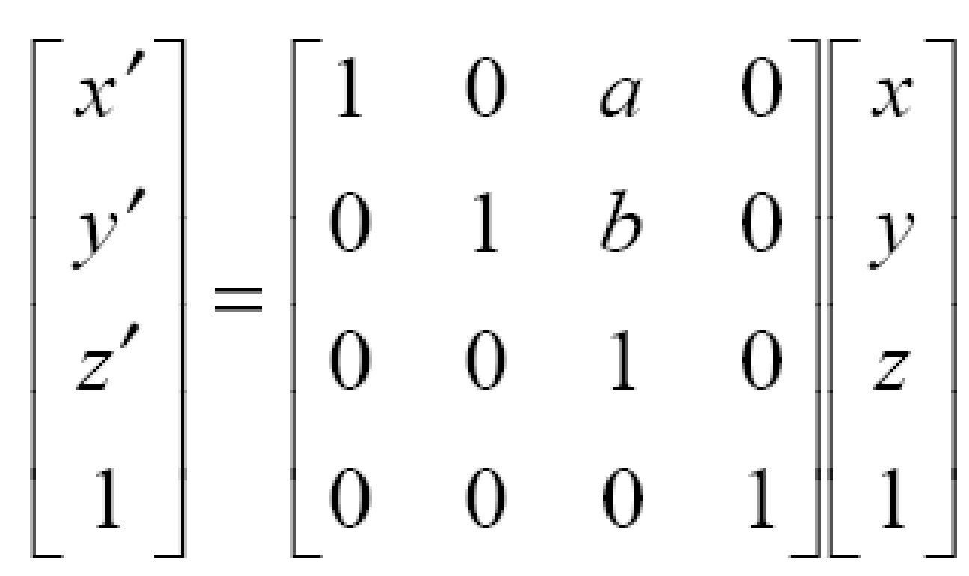
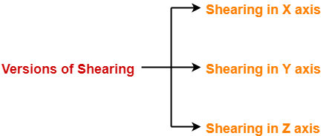
3D Transformations (Shearing)
A Transformation that distorts the shape of an object such that the transformed shape appears as if the object were decomposed of internal layers that had been caused to slide over each other is called a shearing
In 2-D, transformations relative to X or Y axis to produce distortion in the shapes of objects. In 3-D, we can also generate shears relative to Z-axis.
Matrix for 3D shearing, Where a and b can Be assigned any real Value.
Department of CSE, Daffodil International University
‹#›

Slide 21
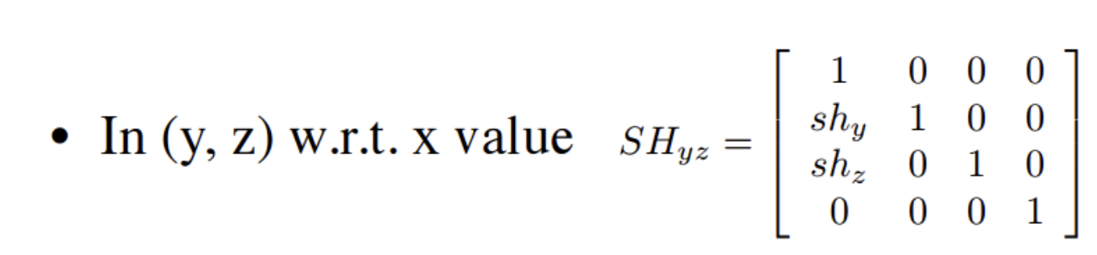
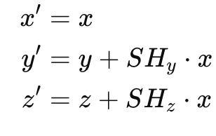
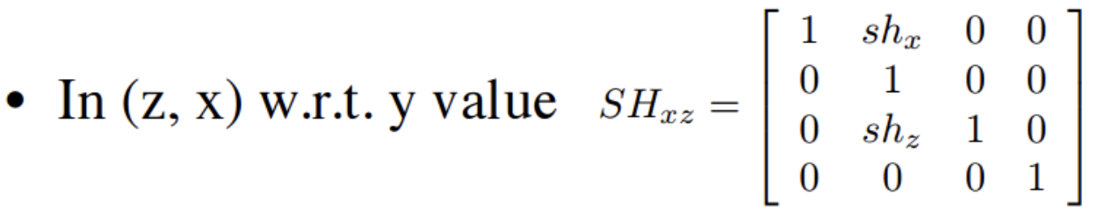
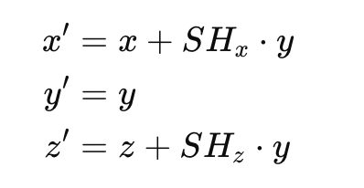
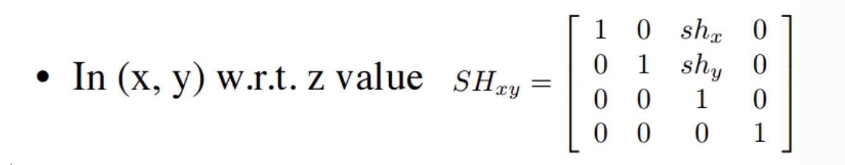
3D Transformations (Shearing)
Shearing in x-direction
Here the coordinate of X remains unchanged while the coordinates of Y and Z are changed.
Shearing in y-direction
Here the coordinate of Y remains unchanged while the coordinates of X and Z are changed.
Shearing in z-direction
Here the coordinate of Z remains unchanged while the coordinates of X and Y are changed.
Department of CSE, Daffodil International University

Slide 22
3D Transformations (Shearing Example)
Given a 3D triangle with points (0, 0, 0), (1, 1, 2) and (1, 1, 3). Apply shear parameter 2 on X axis find out the new coordinates of the object.
Solution:
Triangle vertices:
A(0, 0, 0)
B(1, 1, 2)
C(1, 1, 3)
Shearing parameters: SHx = 2, SHy = 2, SHz = 3
x' = x
y' = y + SHy · x
z' = z + SHz · x
Shearing about X-axis
For point A (0,0,0)
x' = x = 0
y' = y + SHy · x = 0 + 2× 0 = 0
z' = z + SHz · x = 0 + 3×0 = 0
Scaled Point A' (0, 0, 0)
For point B (1, 1, 2)
x' = x = 1
y' = y + SHy · x = 1 + 2× 1 = 3
z' = z + SHz · x = 2 + 3×1 = 5
Scaled Point B' (1, 3, 5)
For point C (1, 1, 3)
x' = x = 1
y' = y + SHy · x = 1 + 2× 1 = 3
z' = z + SHz · x = 3 + 3×1 = 6
Scaled Point B' (1, 3, 6)
Department of CSE, Daffodil International University

Slide 23

Department of CSE, Daffodil International University
‹#›
Notes:
‹#›

